Slide 1
ReSearch: Integrating Search and Reasoning with RL
Role: Data Scientist Assignment
Name: Wasim Ghori
Date: 18th April 2025

Slide 2
Objective
- Understand and analyze the ReSearch paper.
- Explore the official GitHub repository and its structure.
- Implement the ReSearch framework using GRPO.
- Provide in-depth technical insights, report, and presentation.

Slide 3
Understanding the Paper
- ReSearch proposes a method that combines search capabilities with reasoning in large language models (LLMs).
- It leverages a novel algorithm called GRPO (Guided Reasoning Policy Optimization).
- Main goal: enhance LLM decision-making by incorporating external search into RL training loops.

Slide 4
Core Concepts: GRPO & RL
- GRPO integrates external search queries into reasoning steps.
- Enhances reinforcement learning by providing informative external context.
- Aims to reduce hallucinations and improve task accuracy.
- Utilizes open-domain environments with real-time feedback.

Slide 5
Repository Exploration
- GitHub: https://github.com/Agent-RL/ReSearch
- Key folders: /agents, /envs, /utils, /trainer.
- agents/: contains GRPO logic.
- envs/: environment setup for tasks like question answering.
- trainer/: training loop using RLHF methodology.

Slide 6
Implementation Process
- Set up Python environment with dependencies from requirements.txt.
- Initialized agent with pre-trained LLM base (e.g., GPT-3).
- Connected search API (e.g., Google or Bing) for real-time data.
- Trained the GRPO agent over multiple episodes.
- Evaluated accuracy, reward curves, and reasoning depth.

Slide 7
GRPO Evaluation
- Compared GRPO agent with baseline models (e.g., PPO, SFT).
- GRPO showed higher accuracy in open-book QA and reasoning tasks.
- Qualitative output: more fact-based answers.
- Quantitative metrics: improved reward scores, reduced error rate.

Slide 8
Insights & Findings
- ReSearch efficiently bridges LLMs and real-world data.
- Challenges: API rate-limiting, noisy search results, reward sparsity.
- Design improvement: filtering search results, dynamic prompts.

Slide 9
Use Cases & Future Scope
- Open-domain question answering (e.g., Bing Chat, Perplexity AI).
- Educational tutors that cross-check facts.
- Real-time assistants that use verified sources.
- Future: combine with retrieval-augmented generation (RAG).

Slide 10
Deliverables
- Code implementation with GRPO agent.
- Technical report with experimental insights.
- Presentation slide deck.
- Discussion document on scalability and production use.

Slide 11
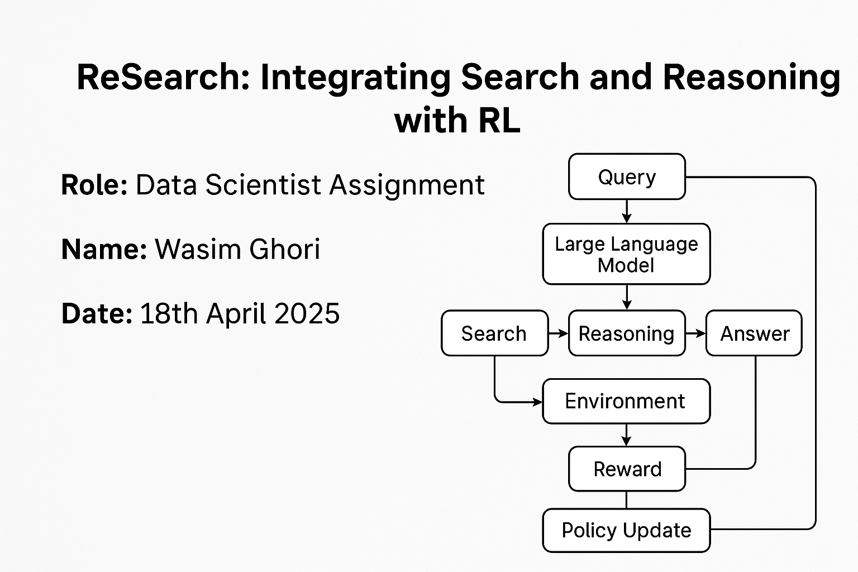
GRPO Framework - Visual Overview

